Slide 1
World domination

Slide 2
Oath Keepers
LogIn
Sign Up

Slide 3
X
ID :
Oath Keepers
Password :
Log In
Login
Sign Up

Slide 4
X
ID :
Oath Keepers
Password :
Email :
Register
Login
Sign Up

Slide 5
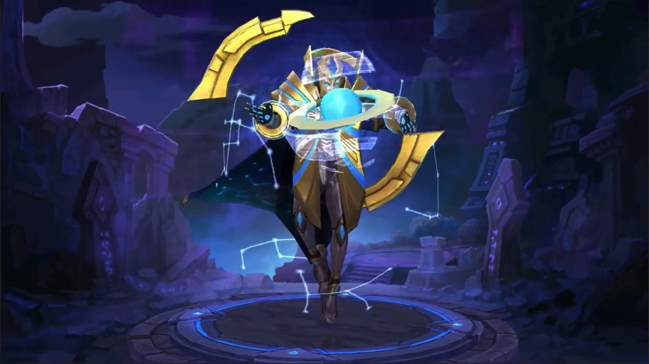
Oath Keepers
Loading Game
Continue
Tips : Login everyday to receive your daily reward!

Slide 6
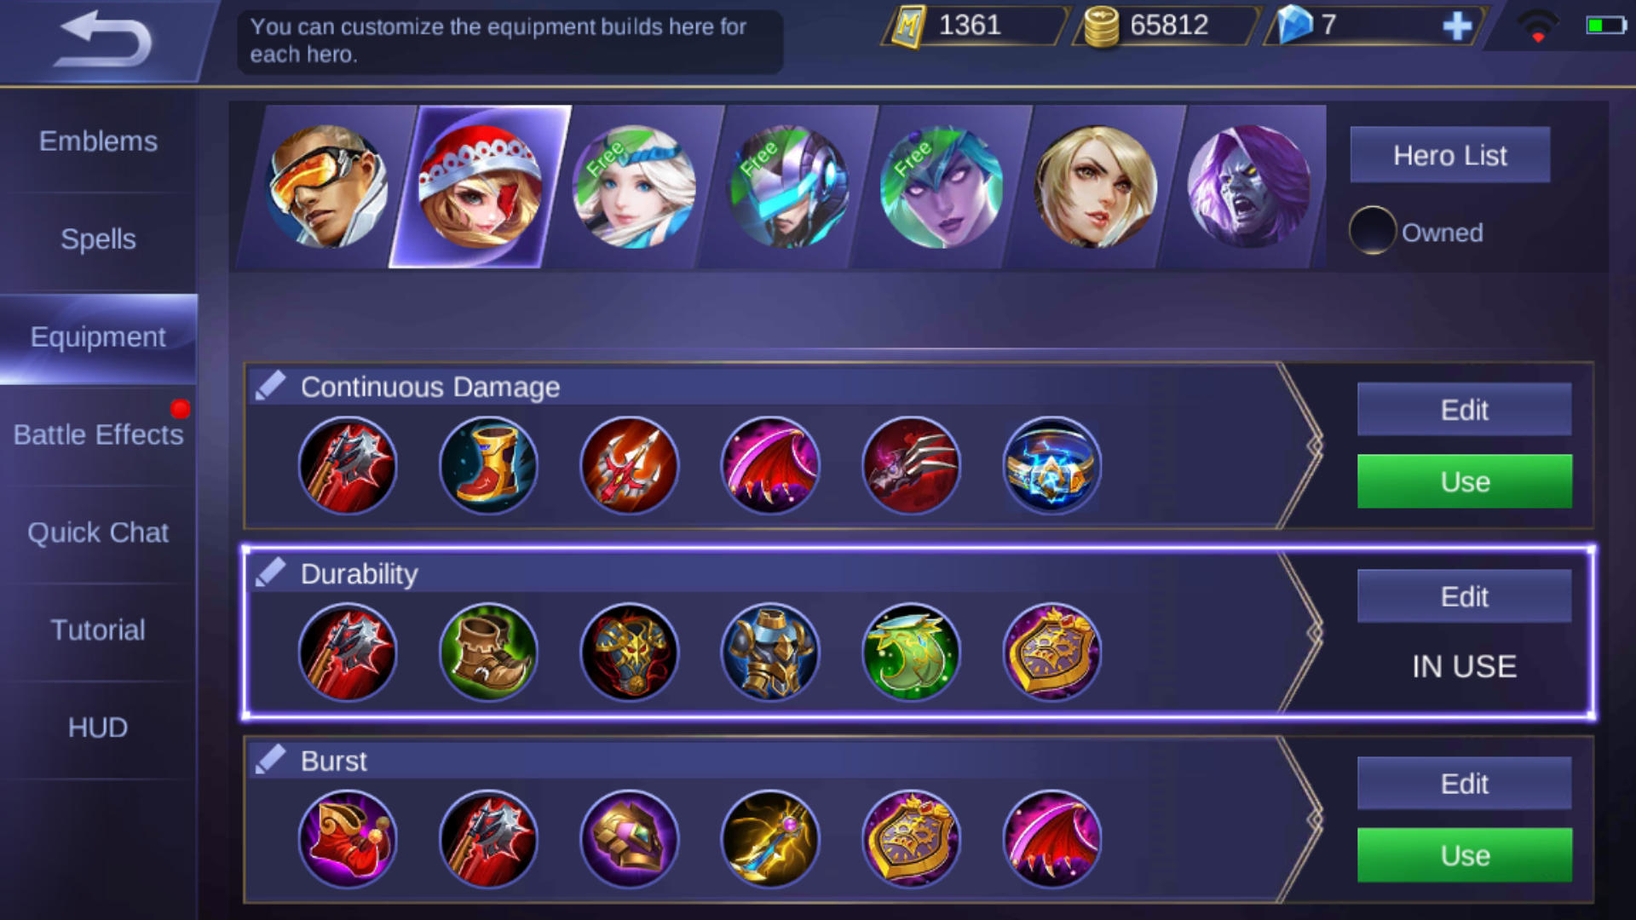
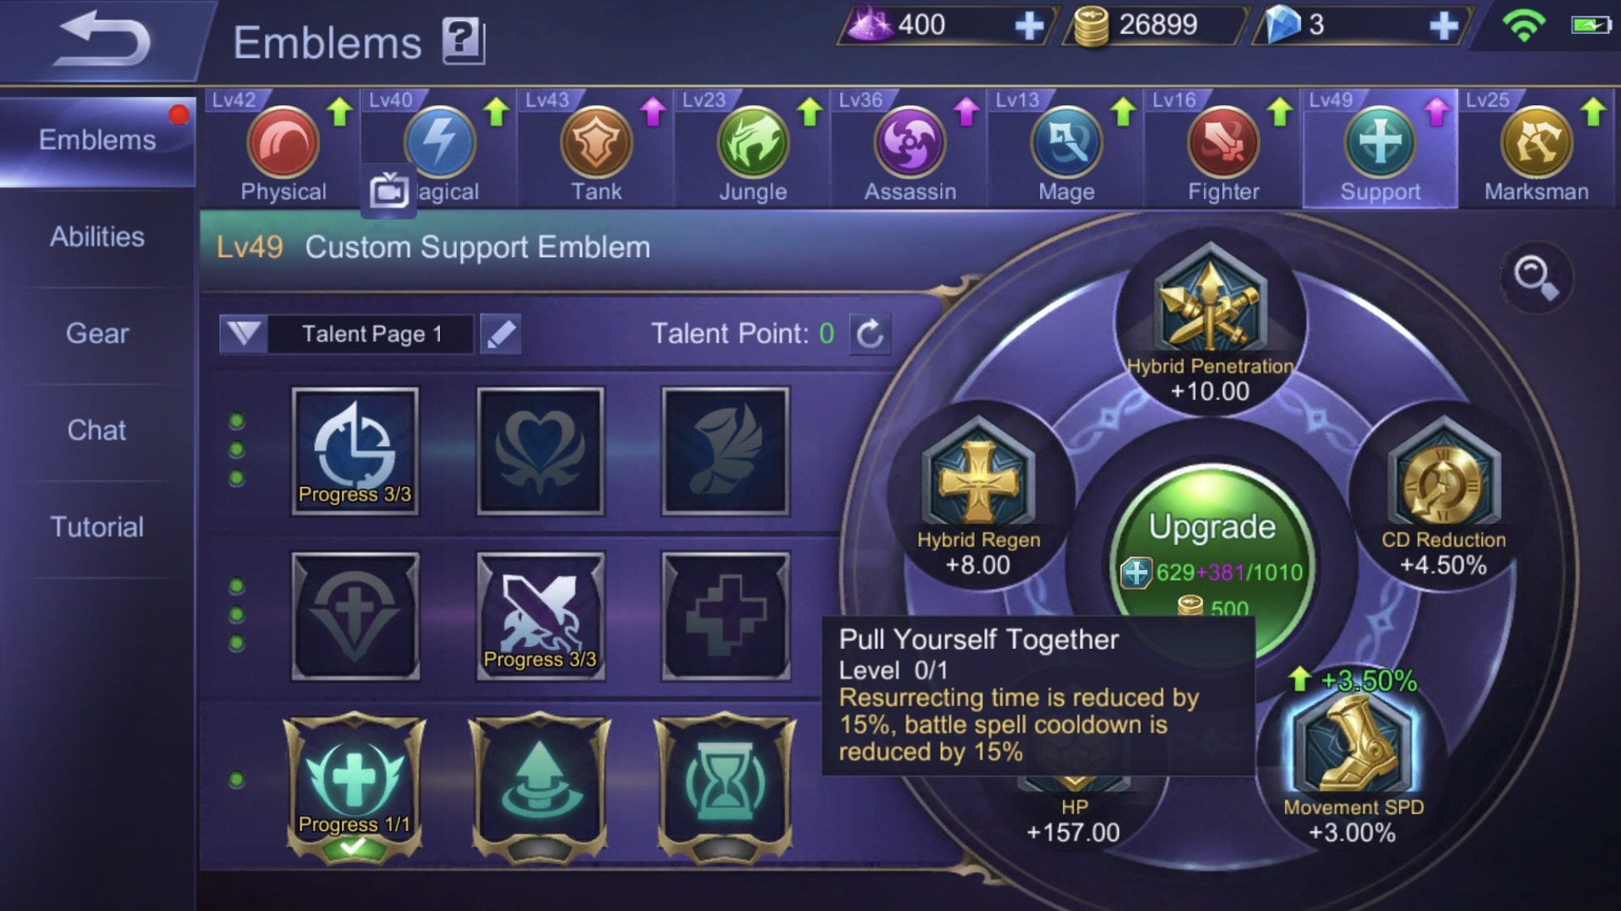

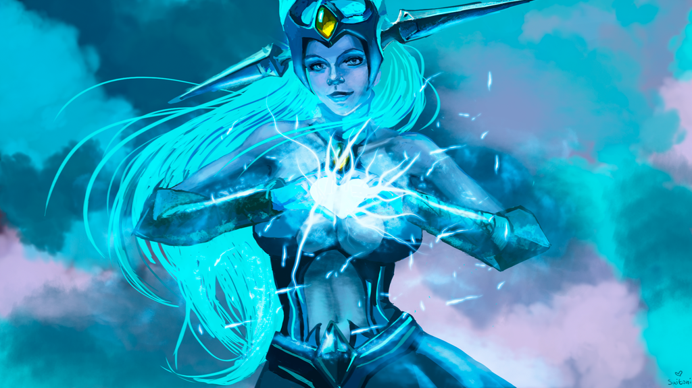
Username Level 1
A
135,000
42,000
41
E
C
200/315 XP
Shop
NEW HERO!
Elleanor
Buy Now at the SHOP
S
Quest
f
Social
y
Inventory
M
Go To Lobby

Slide 7
Username Level 1
A
Graphic
Quality
Shadow Quality
Fullscreen
V-Sync
Anti-Aliasing
N
135,000
42,000
41
E
C
135,000
42,000
41
E
C
200/315 XP
200/315 XP
Low
Medium
High
Audio
NEWS!
Shop
NEWS!
S
Low
Medium
High
Control
Quest
f
Language
Social
y
Go To Lobby
Inventory
Go To Lobby
M

Slide 8
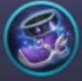
N
Inbox
Sender : Oath Keeper Team
Hey! Do you…
Subject : Welcome to Oath Keeper!
Welcome to Oath Keeper, (Player’s Nickname)!
We are glad to have you here as one of the newest keeper. We hope that with you here, there will be no more broken promises between the Light and the Dark.
Here is a few gifts from the Watcher to help your journey!
Update 1.2
Report Feedback
Update 1.1
Welcome to Oath…
Take Item
Reply

Slide 9
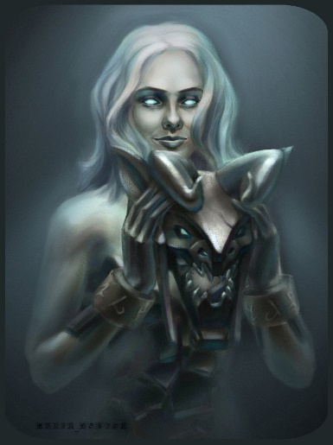
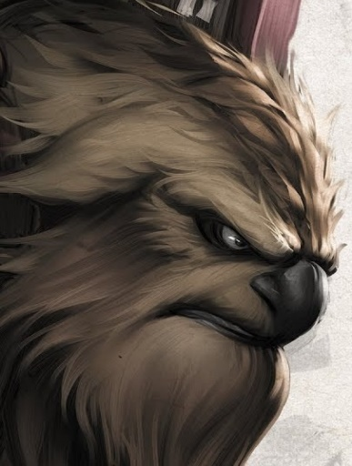
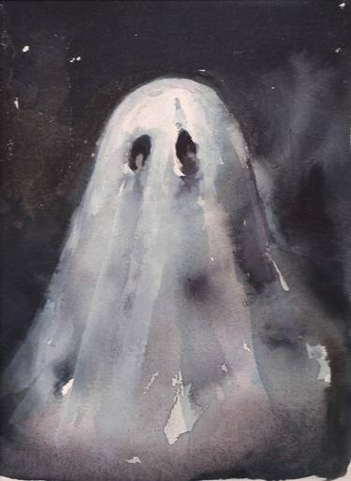

N
Hero
Skin
Mystery Box
135,000
42,000
41
All
Archer
Assassin
Mage
Warrior
Support
Tanker
Hero Portrait
Hero Portrait
Hero Portrait
Hero Portrait
Aria
Noez
Ghostie
Elleanor
L
L
L
L

Slide 10
N
Level 1
200/315 XP
Ongoing
Complete
Tutorial
Oath Keeper
Own 1 Keeper
O
Fulfilling My Destiny
Win Any Match
X
Tutorial
Complete Tutorial
O

Slide 11

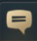


N
A
Your Username
Level 1
Friends
Guild
A
Friend Username
Level 41
A
Friend Username
Level 20
A
Friend Username
Level 5

Slide 12
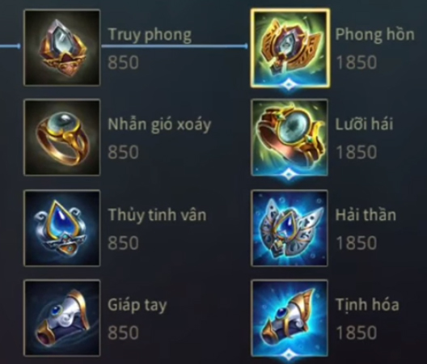
A
Your Username
Level 1
N
135,000
42,000
41
Inventory
Material
Crafting

Slide 13
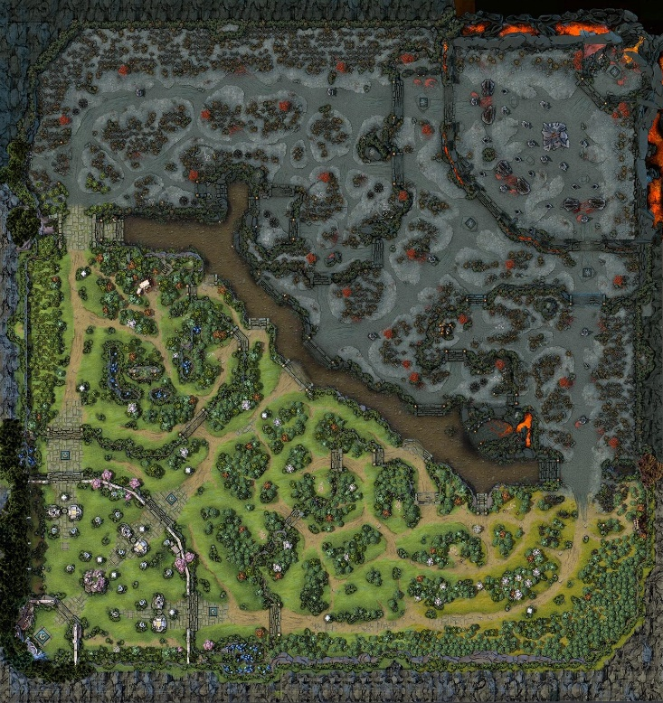
Username Level 1
A
N
135,000
42,000
41
C
200/315 XP
Quick Match
Map Preview
[lobby] Spearhead: 1v1 me loser
[global] Skyman64: Buying green crystal
[global] Rune95: Trading dark sword -> pristine diamond
[lobby] Jaxson: How do I start the game?
[global] Spearhead: Why are you even playing?
[global] Rune95: ???
[global] Spearhead: Sorry, I meant to type it for team chat
[global] Sepiroth13: lmao, dumb shit
[global] Sepiroth13 has been banned for reason: Swearing
[global] Rune95: nice.
r
Ranked
Match
s
Team
Match
A
Custom
Match
Q
Play
Enter your chat here…
A

Slide 14
Username Level 1
A
C
Graphic
Quality
Shadow Quality
Fullscreen
V-Sync
Anti-Aliasing
135,000
42,000
41
E
N
135,000
42,000
41
135,000
42,000
41
E
200/315 XP
200/315 XP
200/315 XP
Low
Medium
High
Quick Match
Map Preview
[lobby] Spearhead: 1v1 me loser
[global] Skyman64: Buying green crystal
[global] Rune95: Trading dark sword -> pristine diamond
[lobby] Jaxson: How do I start the game?
[global] Spearhead: Why are you even playing?
[global] Rune95: ???
[global] Spearhead: Sorry, I meant to type it for team chat
[global] Sepiroth13: lmao, dumb shit
[global] Sepiroth13 has been banned for reason: Swearing
[global] Rune95: nice.
r
Audio
Low
Medium
High
Ranked
Match
s
Control
Team
Match
A
Language
Custom
Match
Go To Lobby
Q
Go To Lobby
Play
Return
Enter your chat here…
A

Slide 15


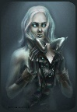


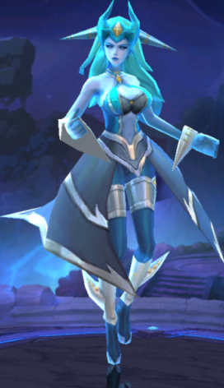




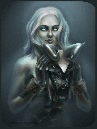





Keeper
Elleanor
Total Win : 3
Total Lose : 1
Winning Percentage: 75%
Name : Elleanor
Type : Mage
Difficulty : ssss
[team] Spearhead: Ready!
[team] Jaxson: How do I pick the hero?
[team] Spearhead: WHY ARE YOU ON MY TEAM?
[team] Starman420: Guys, be patient okay? Jaxson is new here
[team] Starman420: Just pick a portrait of the hero that you own, the one you have would be floating up a little
Skill
Ready

Slide 16


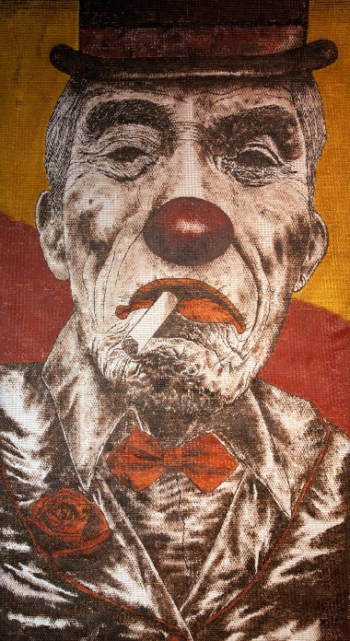
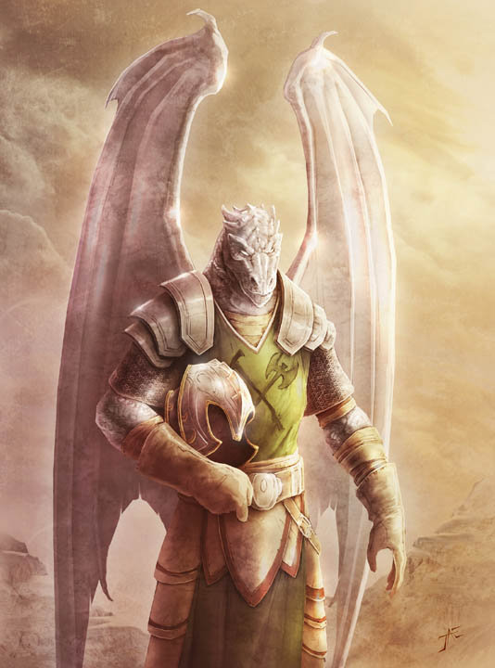
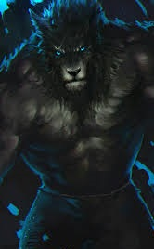
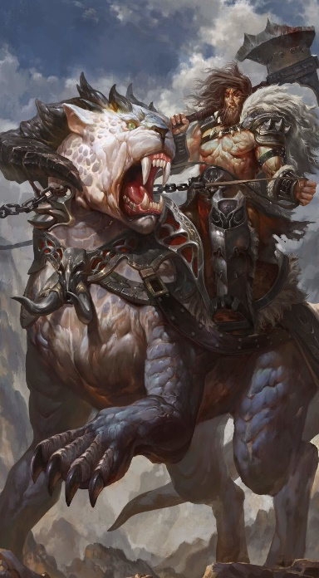
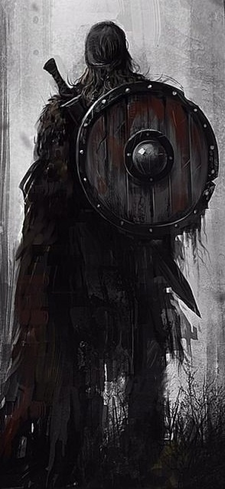

Your Nickname (1)
Bronze I
Spearhead (4)
Bronze I
Jaxson (1)
Bronze
Starman420 (5)
Bronze II
Not_Bot (2)
Bronze I
90%
100%
75%
24%
88%
VS
Dragon942 (1)
Bronze I
XxX_Death_XxX (3)
Bronze I
KING_CRIMSON (5)
Bronze II
7even11even (2)
Bronze I
Mr_Green (1)
Bronze I
45%
18%
100%
100%
98%

Slide 17
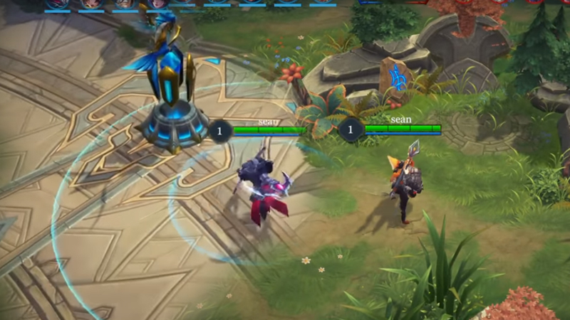




x
7
3
[team] Spearhead: GO GO GO
[team] Jaxson: How to Attack?
[team] Spearhead: DID YOU NOT PLAY THE TUTORIAL?
[team] Starman420: Just press that button which looks like a sword okay!
08:43
SHOP
f
Divine Sword
300 Gold
k
Ritual Knife
250 Gold
H
Ult Skill
Skill 2
Skill 1

Slide 18









x
7
3
[team] Spearhead: GO GO GO
[team] Jaxson: How to Attack?
[team] Spearhead: DID YOU NOT PLAY THE TUTORIAL?
[team] Starman420: Just press that button which looks like a sword okay!
08:43
Skills
x
Defense
SHOP
f
Offense
Divine Sword
300 Gold
k
Ritual Knife
250 Gold
H
Ult Skill
Skill 2
Skill 1

Slide 19



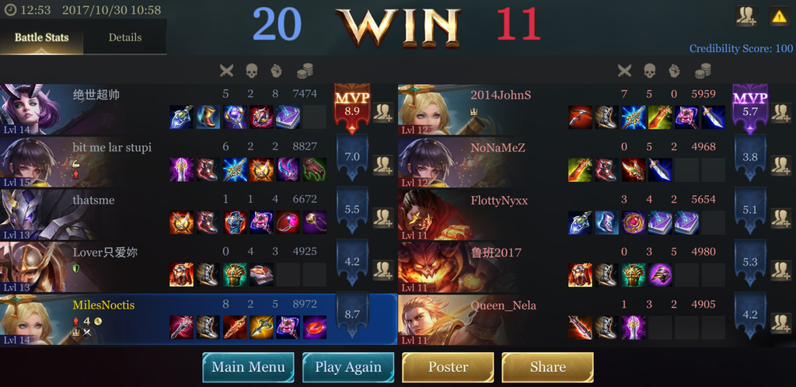
10
4
Match Time : 20:12
Battle Stat
Hero Stat
A
Your Nickname Elleanor
$ 6,180
x
x
x
A
Player’s Name
Hero’s Name
Money
x
x
x
A
Player’s Name
Hero’s Name
Money
x
x
x
A
Player’s Name
Hero’s Name
Money
x
x
x
A
Player’s Name
Hero’s Name
Money
x
x
x
A
Player’s Name
Hero’s Name
Money
x
x
x
A
Player’s Name
Hero’s Name
Money
x
x
x
A
Player’s Name
Hero’s Name
Money
x
x
x
A
Player’s Name
Hero’s Name
Money
x
x
x
A
Player’s Name
Hero’s Name
Money
x
x
x

Slide 20

Next Match in: 00:05
Rewards :
[lobby] Spearhead: GG guys
[lobby] KING_CRIMSON: GG
KING_CRIMSON has left the lobby
[lobby] Dragon942: Good Game
[lobby] Jaxson: How to I take the reward?
[lobby] Spearhead: You’re joking right?
Spearhead has left the lobby
[lobby] Starman420: You don’t pick the reward. It’s already in your inventory
[lobby] Jaxson: Okay, thank you starman
Jaxson has left the lobby
h
G
Money : 6,180
Material : 200
Gems : 1
Leave Lobby

Slide 21
Credits
Angela Karina – 2101626632
Han Josephine – 2101638172
Timothy Arya Adi Wibowo – 2001587883

